Slide 1

All-Year Salary In Us And Shopping Demand In 2021
MENTOR : Đào Văn Tiến Dũng
Nguyễn Hoàng Vũ Thân
Lê Bá Thiện
TEAM : Nguyễn Thị Thanh Thư
Phan Thị Hoài Thúy
Trần Đoàn Bảo Long

Slide 2

All-Year Salary In Us And Shopping Demand In 2021
Content:
Introduction Dataset
Transform data in DataBrick
Connect to data sources (Azure SQL database) in Tableau Server
Visualize data in Tableau Server

Slide 3


Introduction: This is a combination of two Datasets about the salary survey and shopping demand of Americans in 2021
Salary Survey
Superstore
There are 14 Columns and 928 Rows

Slide 4
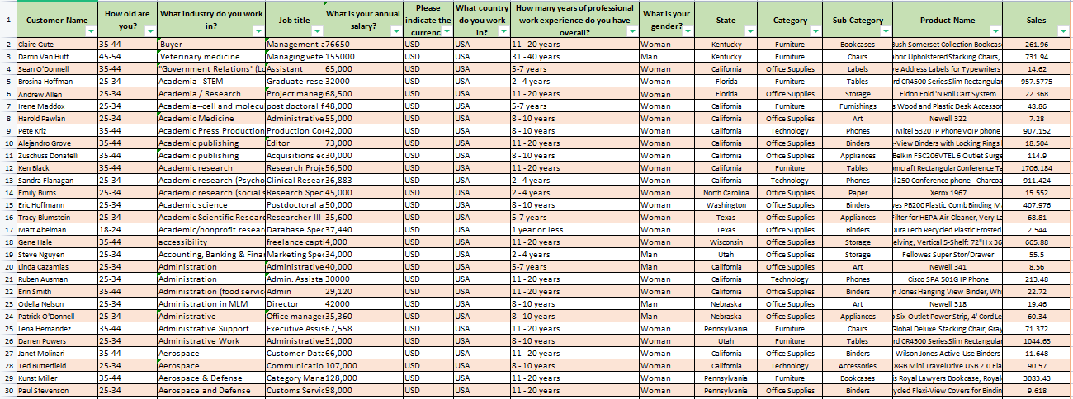
All-Year Salary In Us And Shopping Demand In 2021

Slide 5

Transform DATA IN DATABRICK
Read dataset.
Drop Rows with NULL or None Values and show Dataframe.
Show Duplicate Column from Dataframe.
Drop duplicate rows from DataFrame.

Slide 6
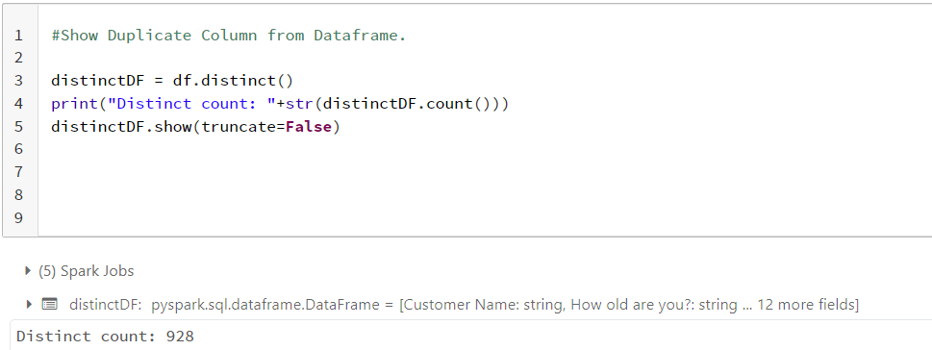
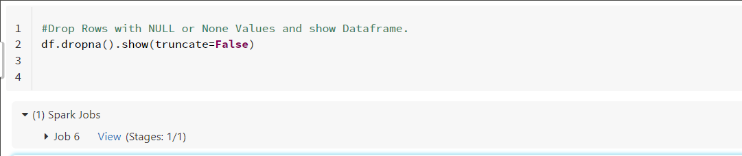

Slide 7
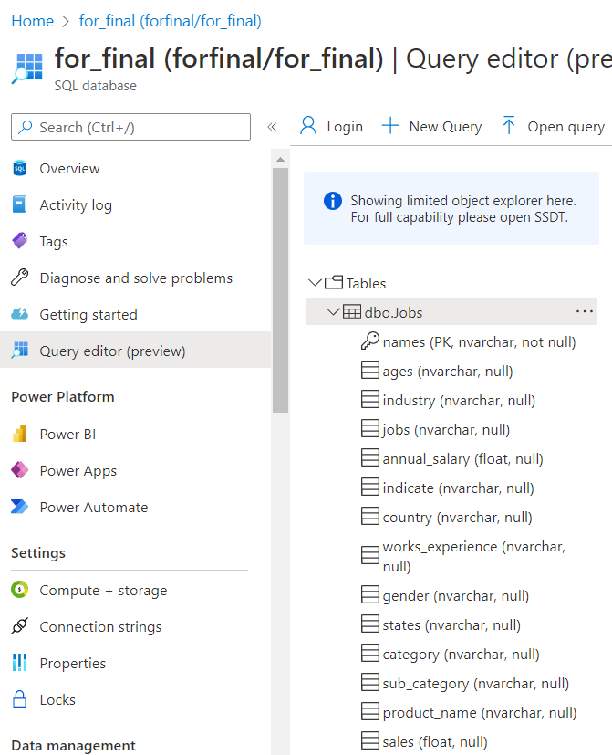
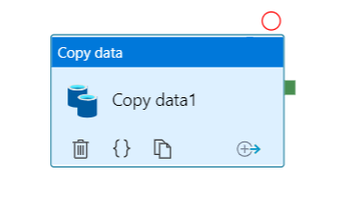


Connect to data sources (Azure SQL database) in Tableau

Slide 8
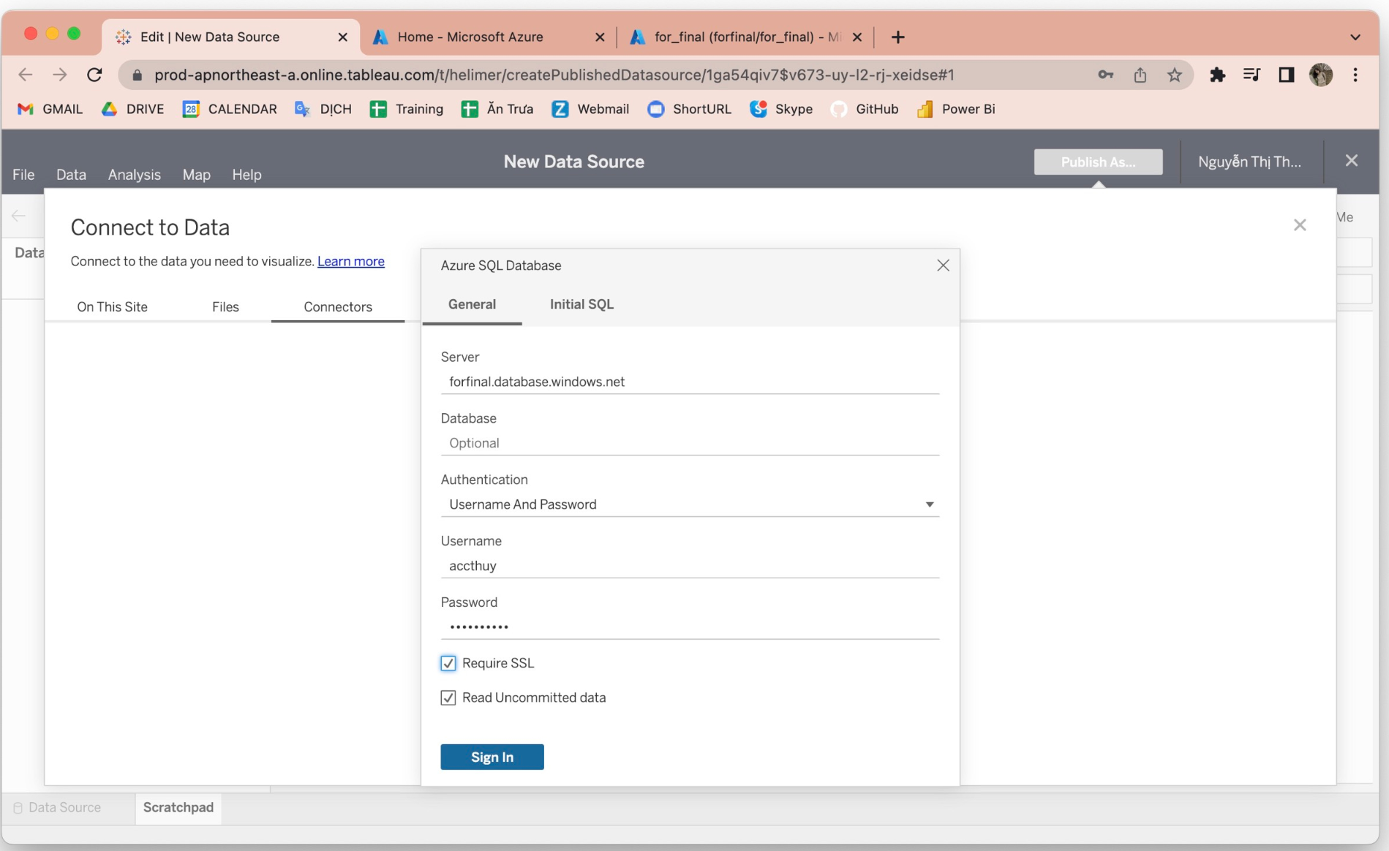
Visualize data in Tableau

Slide 9
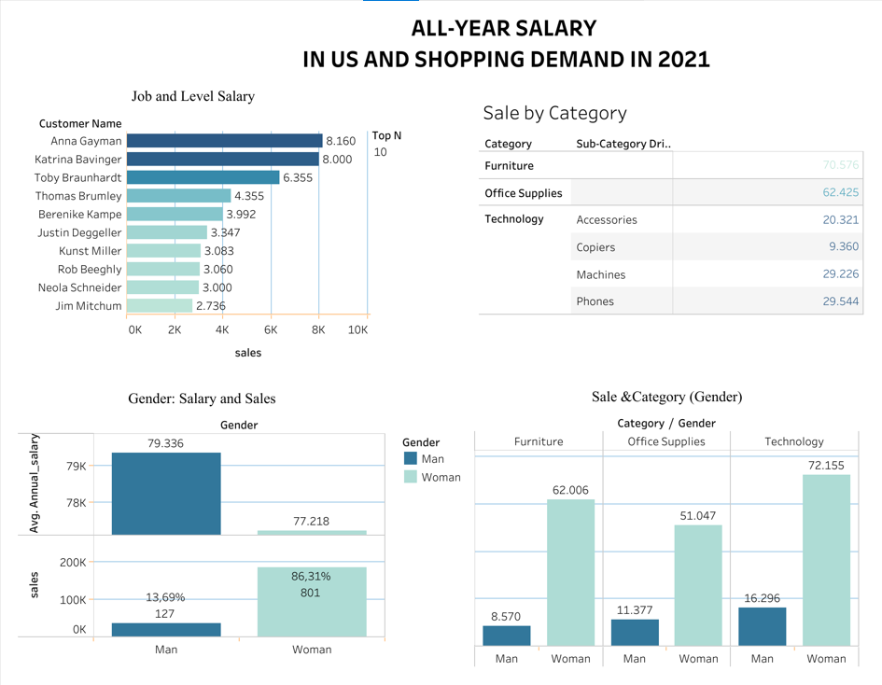
DASHBOARD

Slide 10
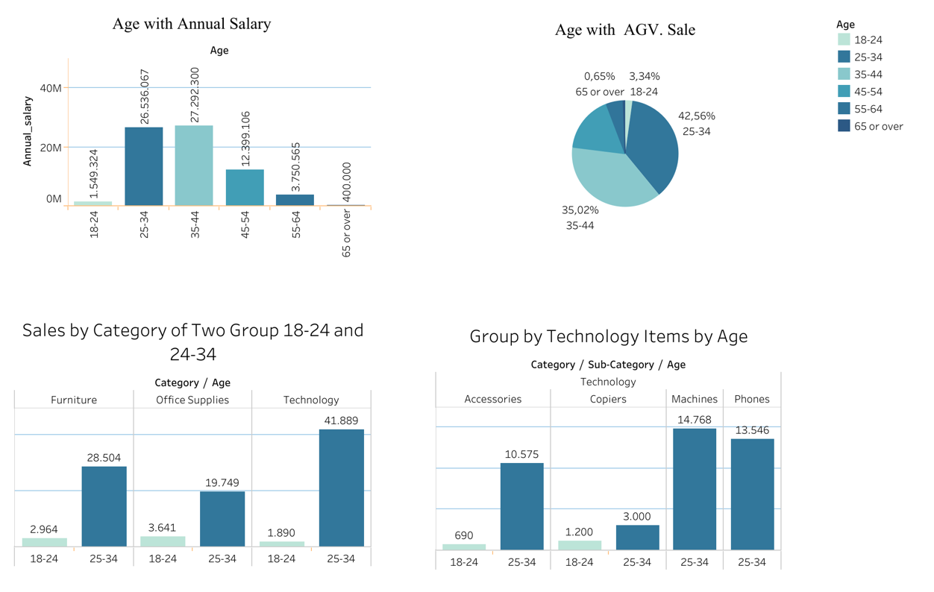
DASHBOARD

Slide 11


Conclusion
In general, salary and shopping demand are proportional.
Spending levels differ significantly by gender and age.
Men's items should be given more attention in order to attract men's shopping needs.
Increase the number of items with a wider range of prices to appeal to the young.

